Slide 1
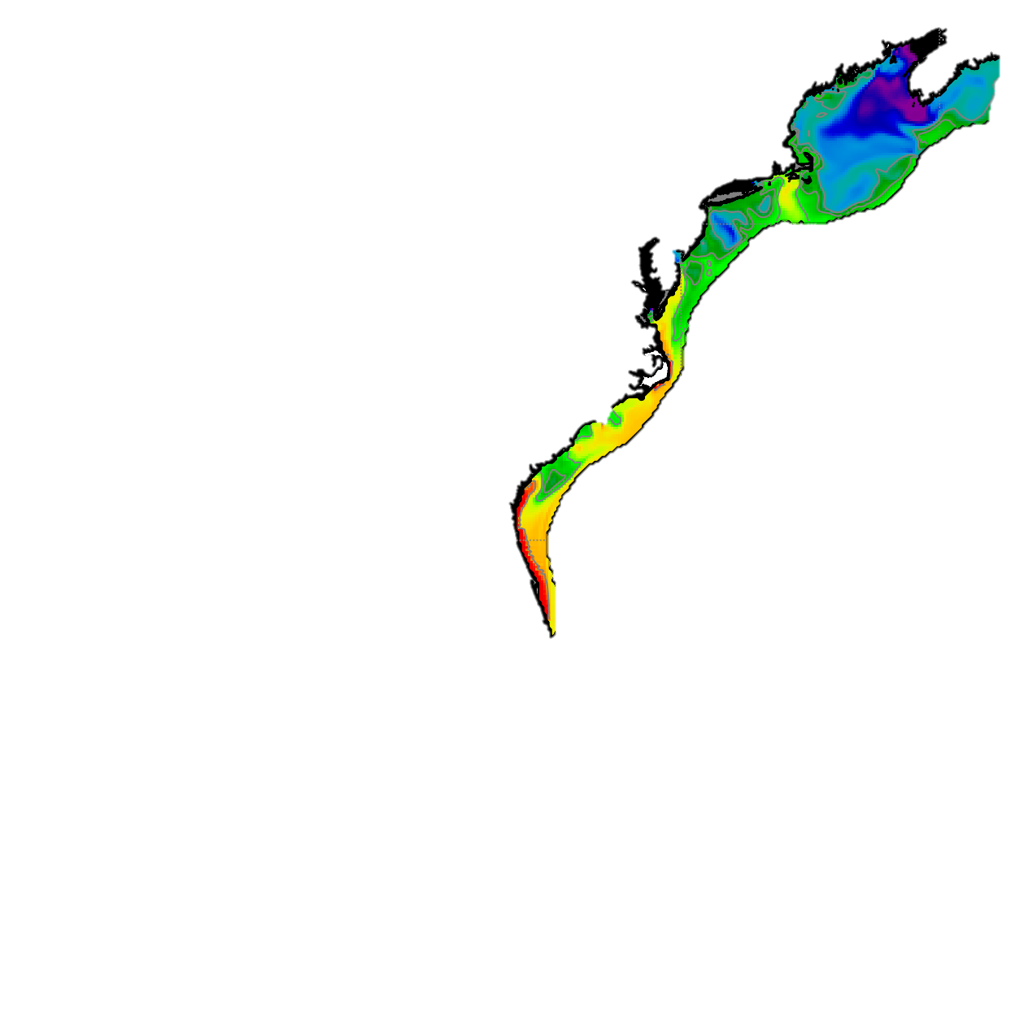
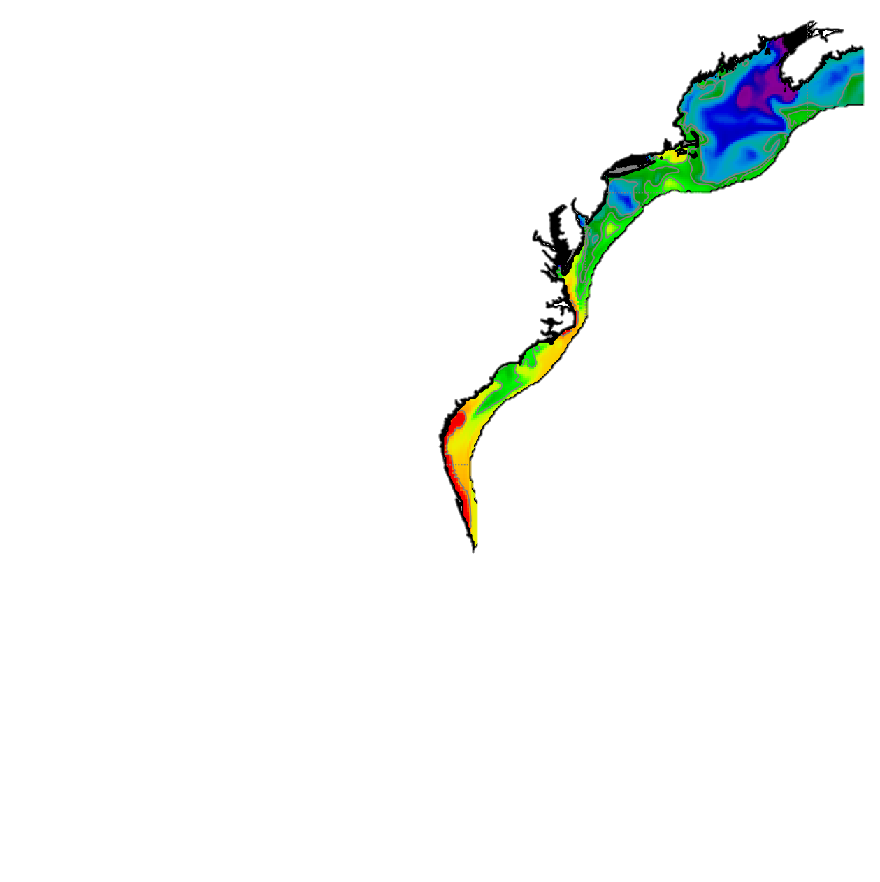

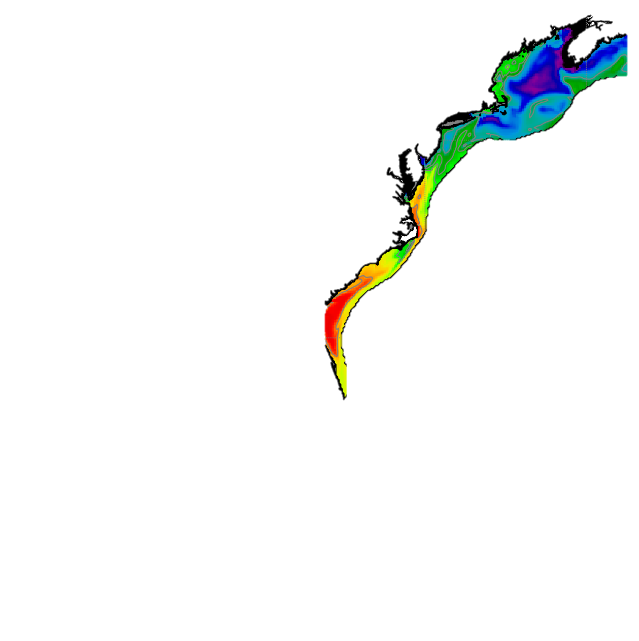
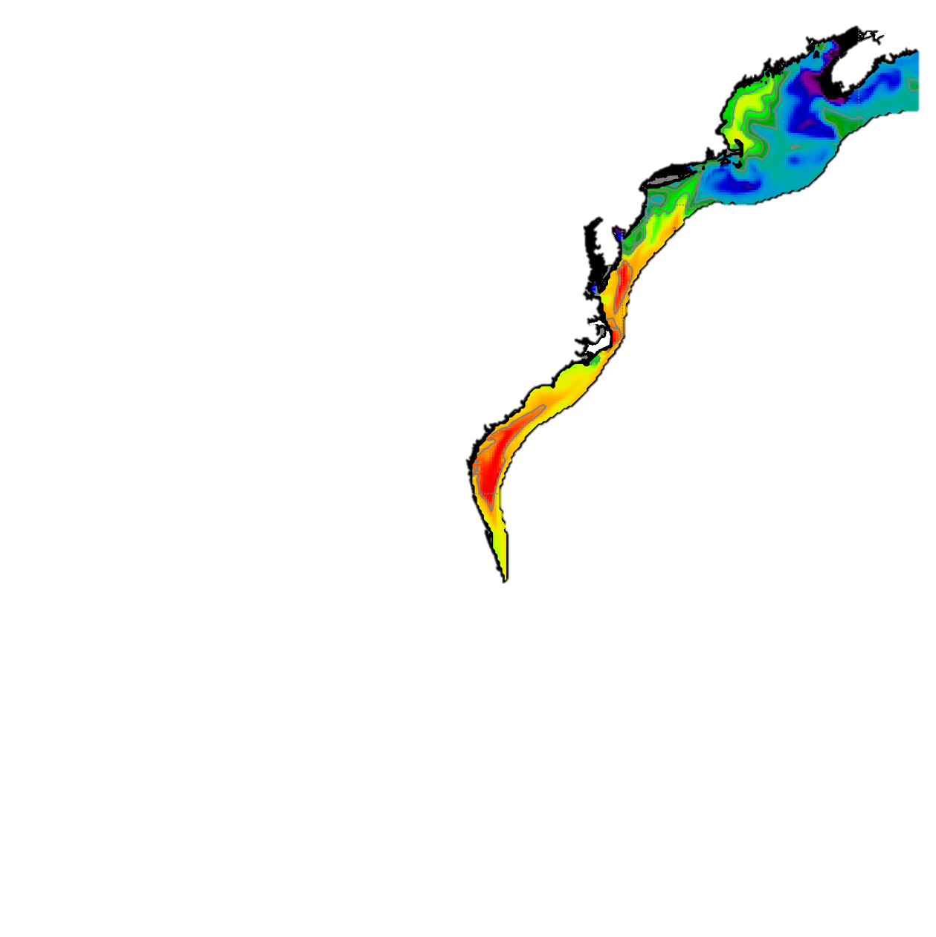
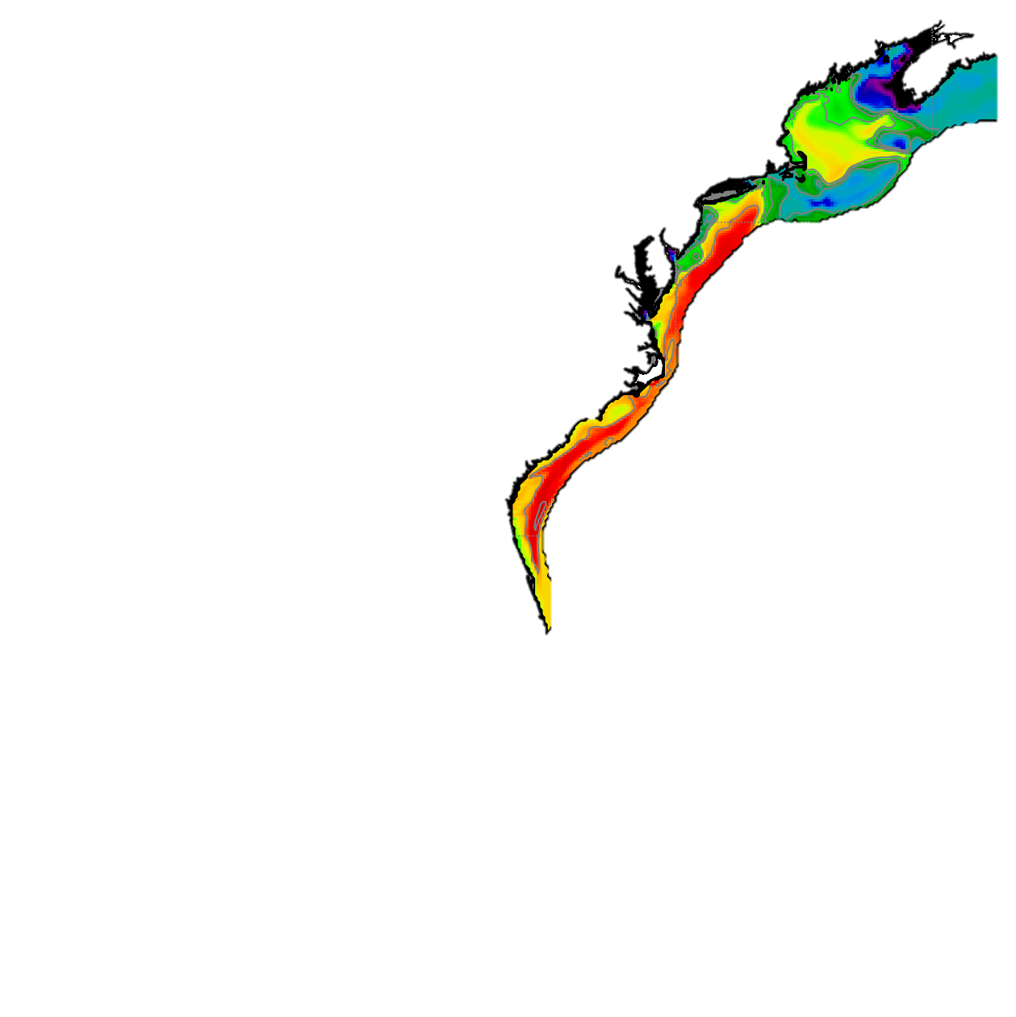
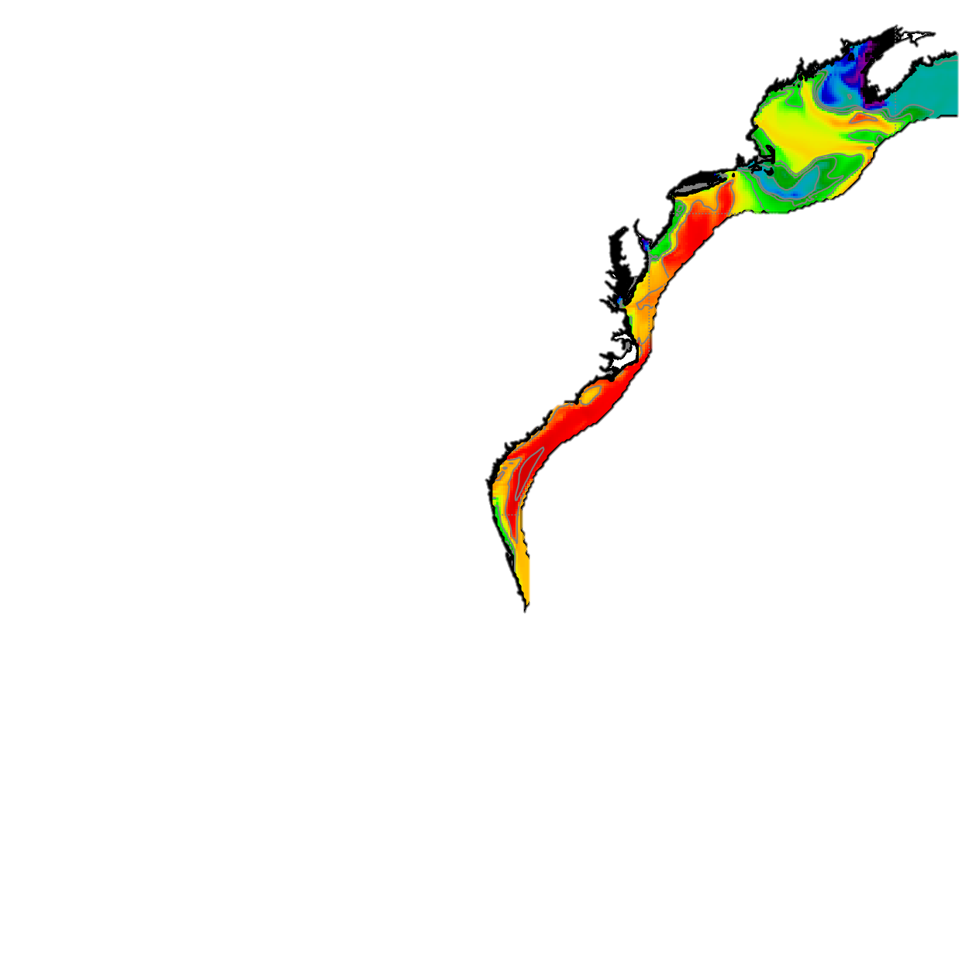
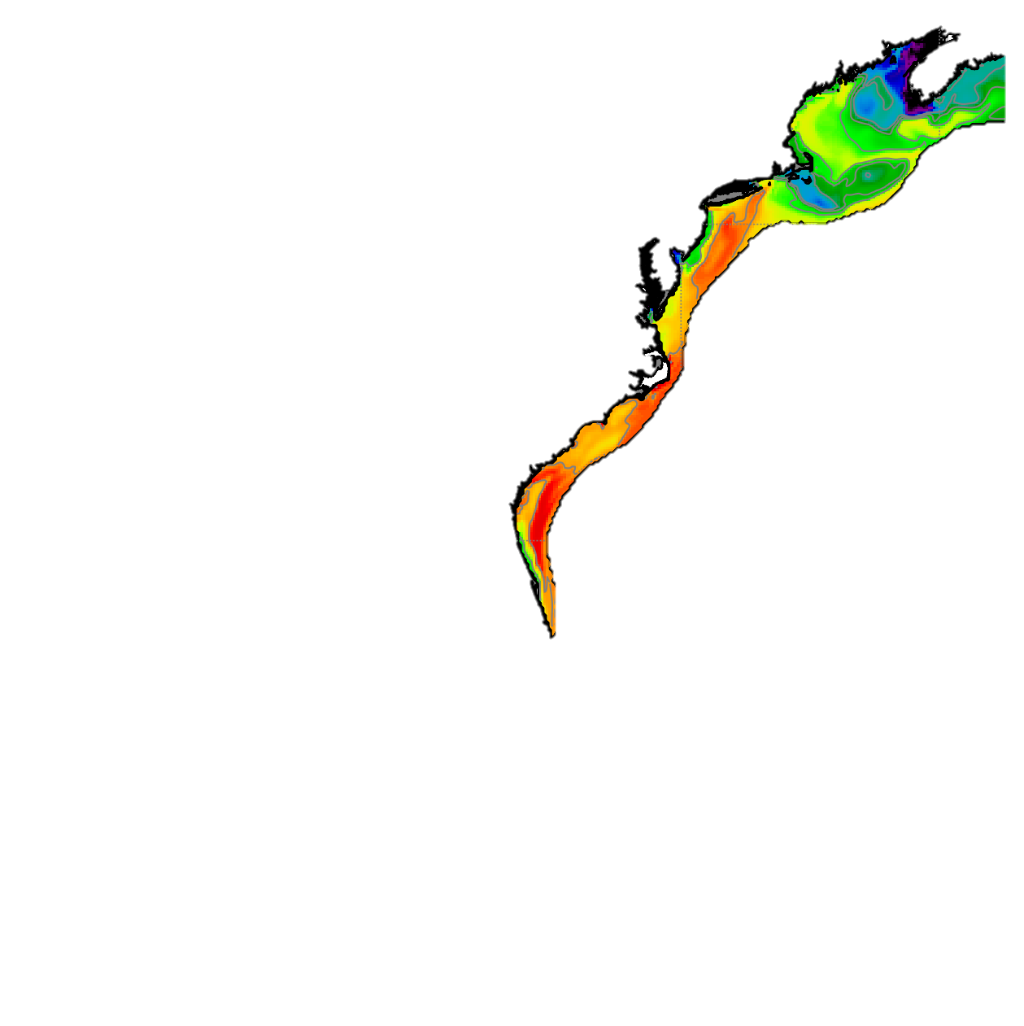
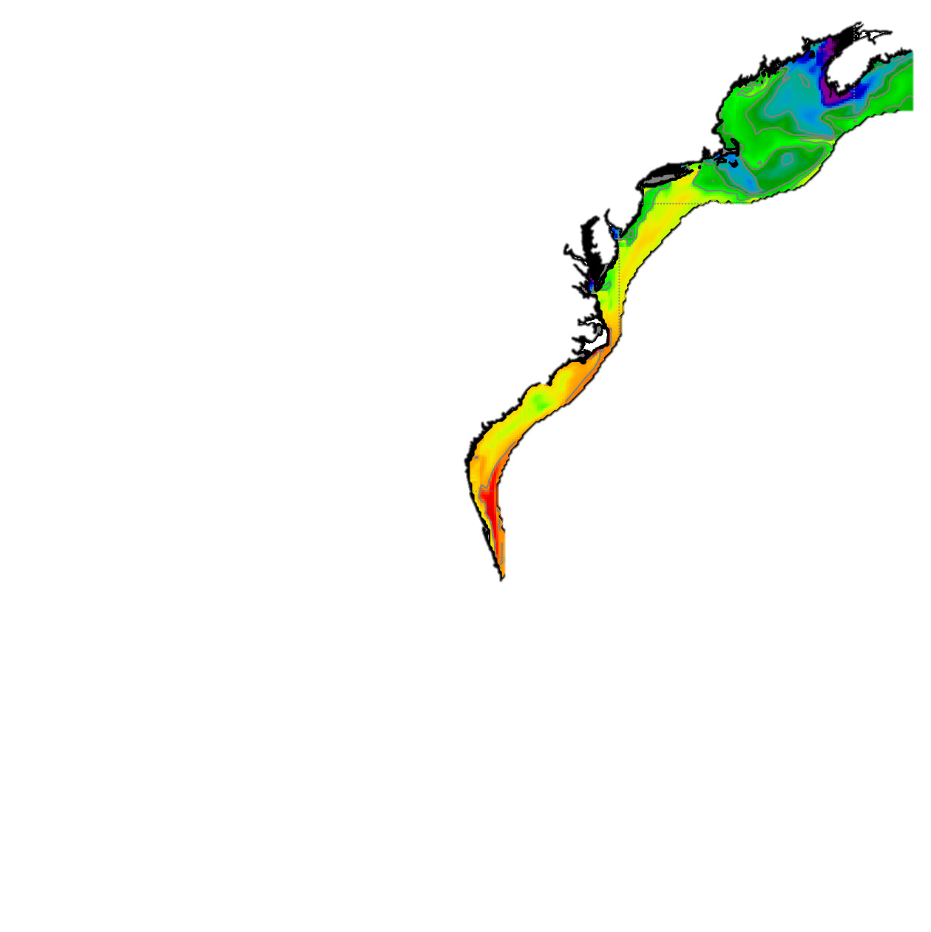
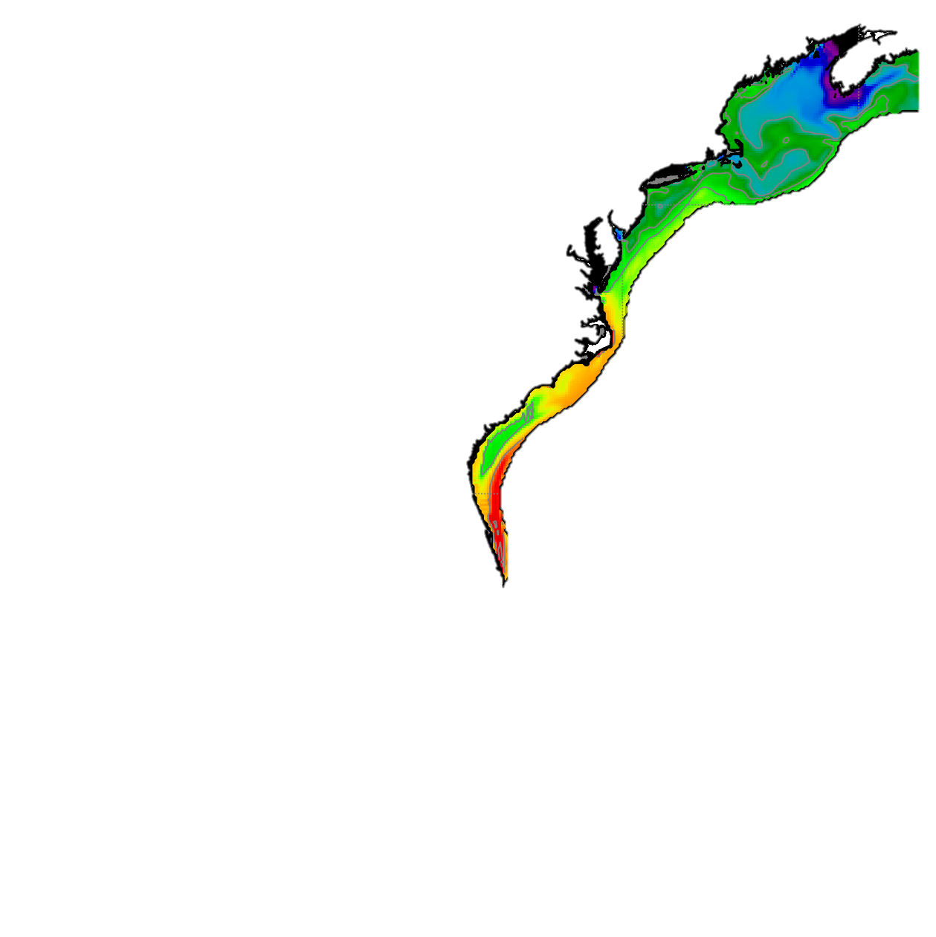
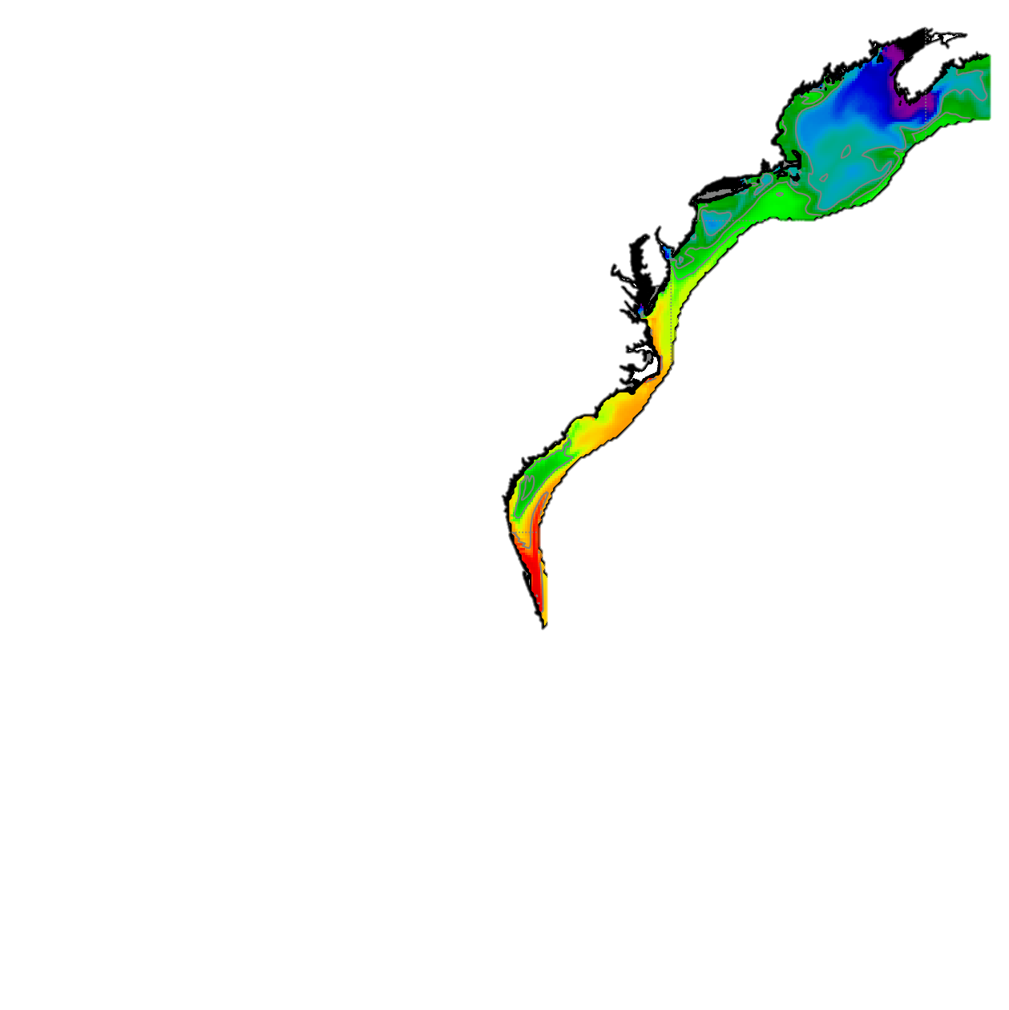
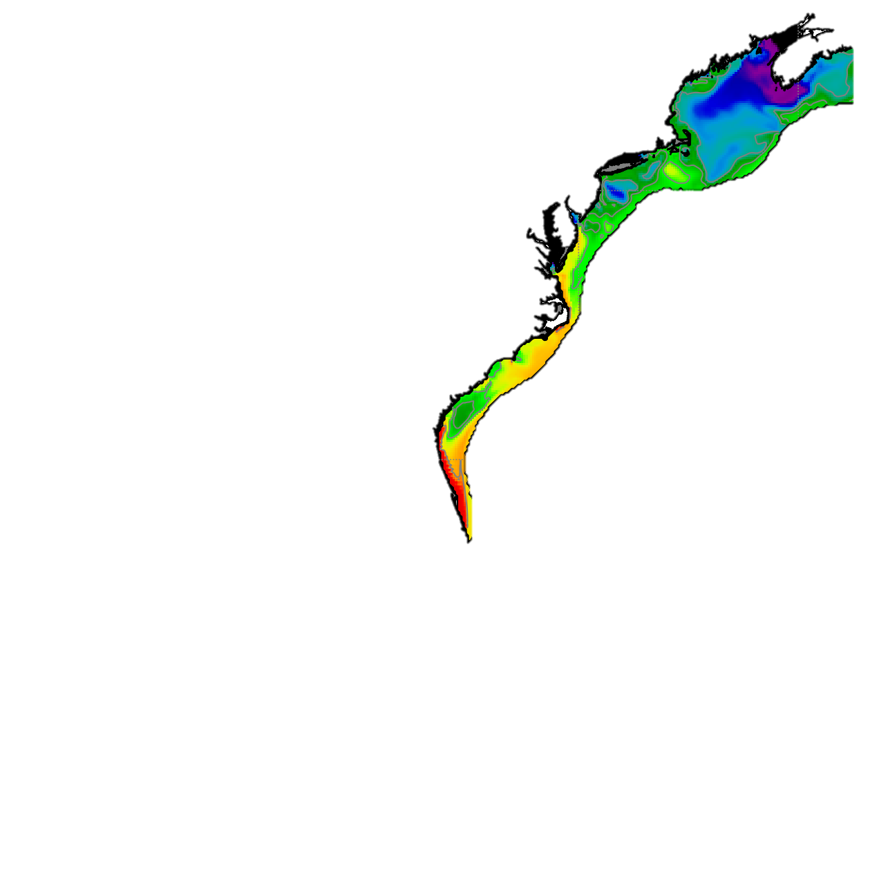
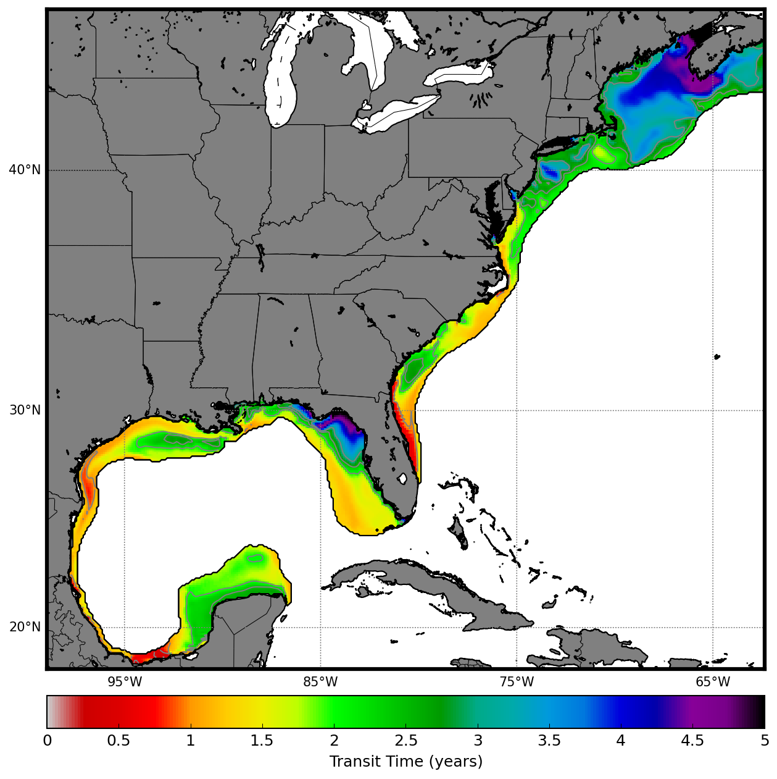
Jan
Feb
Mar
Apr
May
Jun
Jul
Transit time (years)
Aug
Sep
Oct
Nov
Dec

Slide 2
Jan
Feb
Mar
Apr
May
Jun
Jul
Aug
Sep
Oct
Nov
Dec
Transit time (years)

Slide 3
Jan
Feb
Mar
Apr
May
Jun
Jul
Aug
Sep
Oct
Nov
Dec
N
0
0.5
1
1.5
2
2.5
3
3.5
4
4.5
5
Surface Transit Time (years)
Rotation: 41
Size: 60%

Slide 4
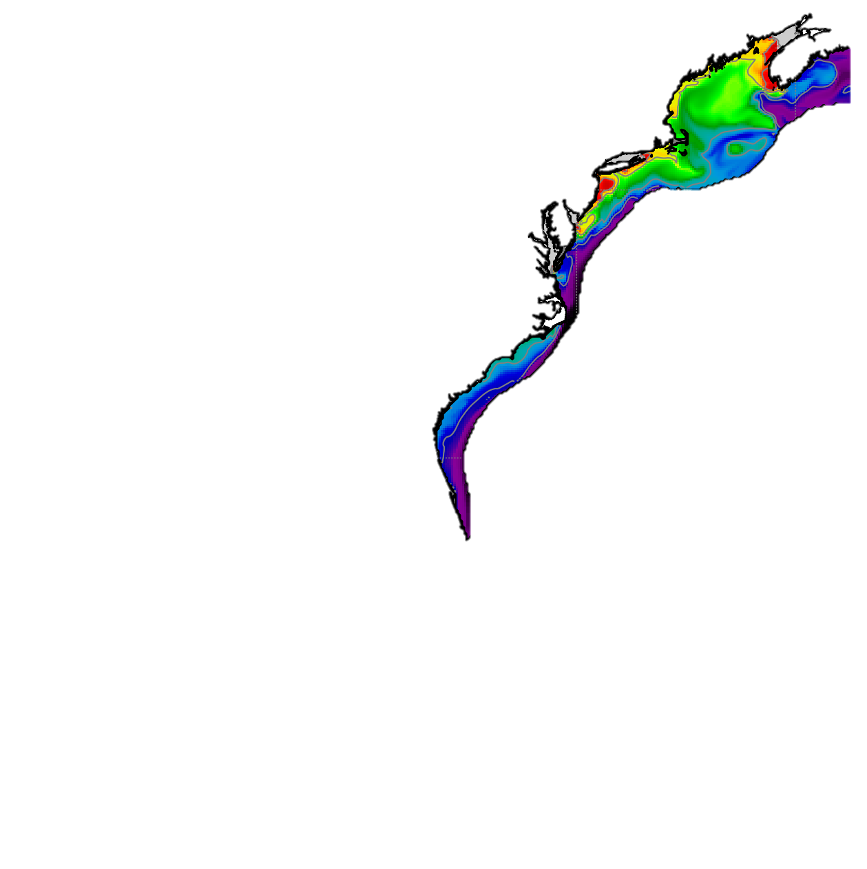
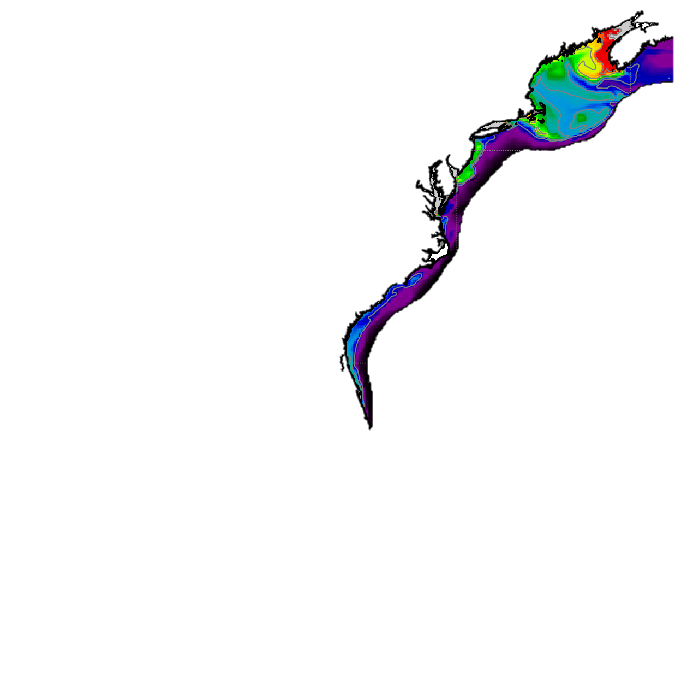
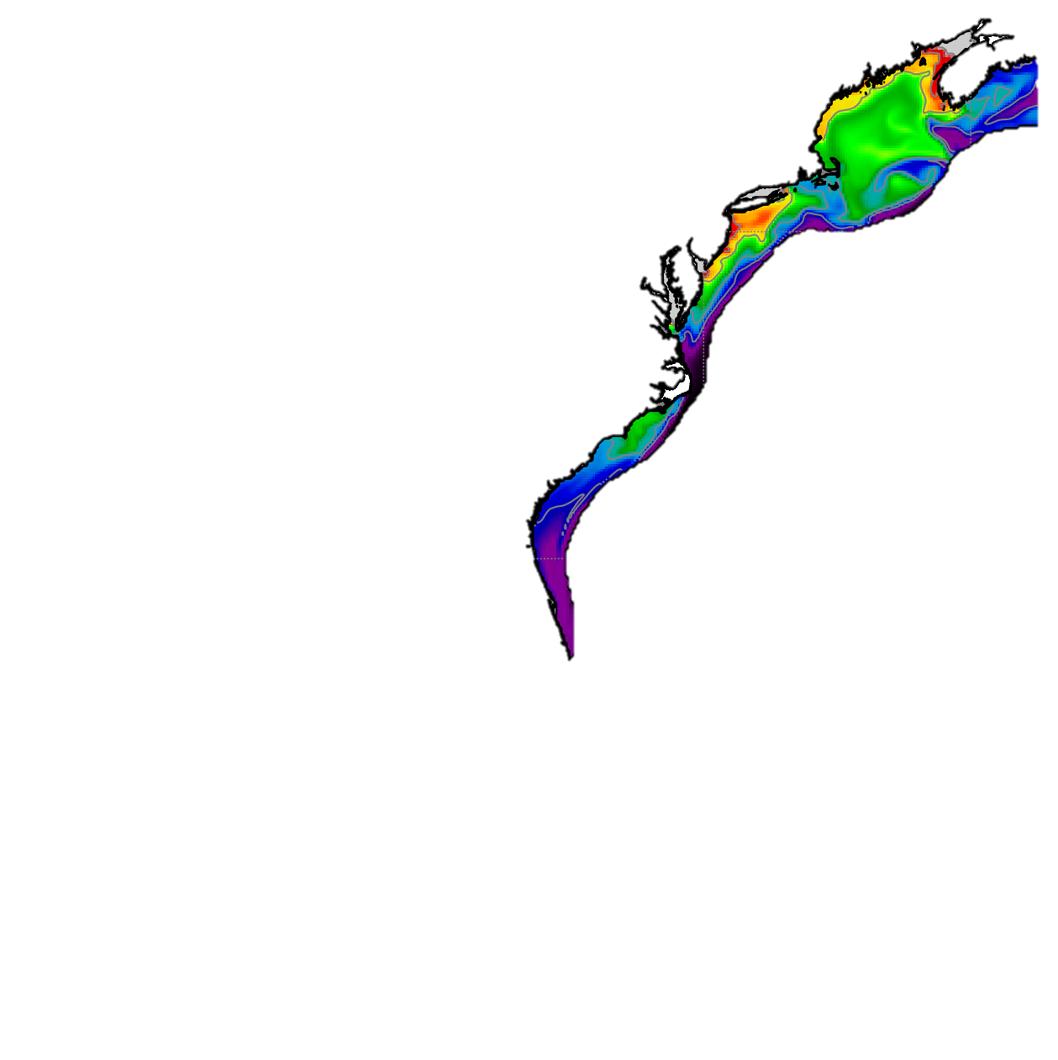
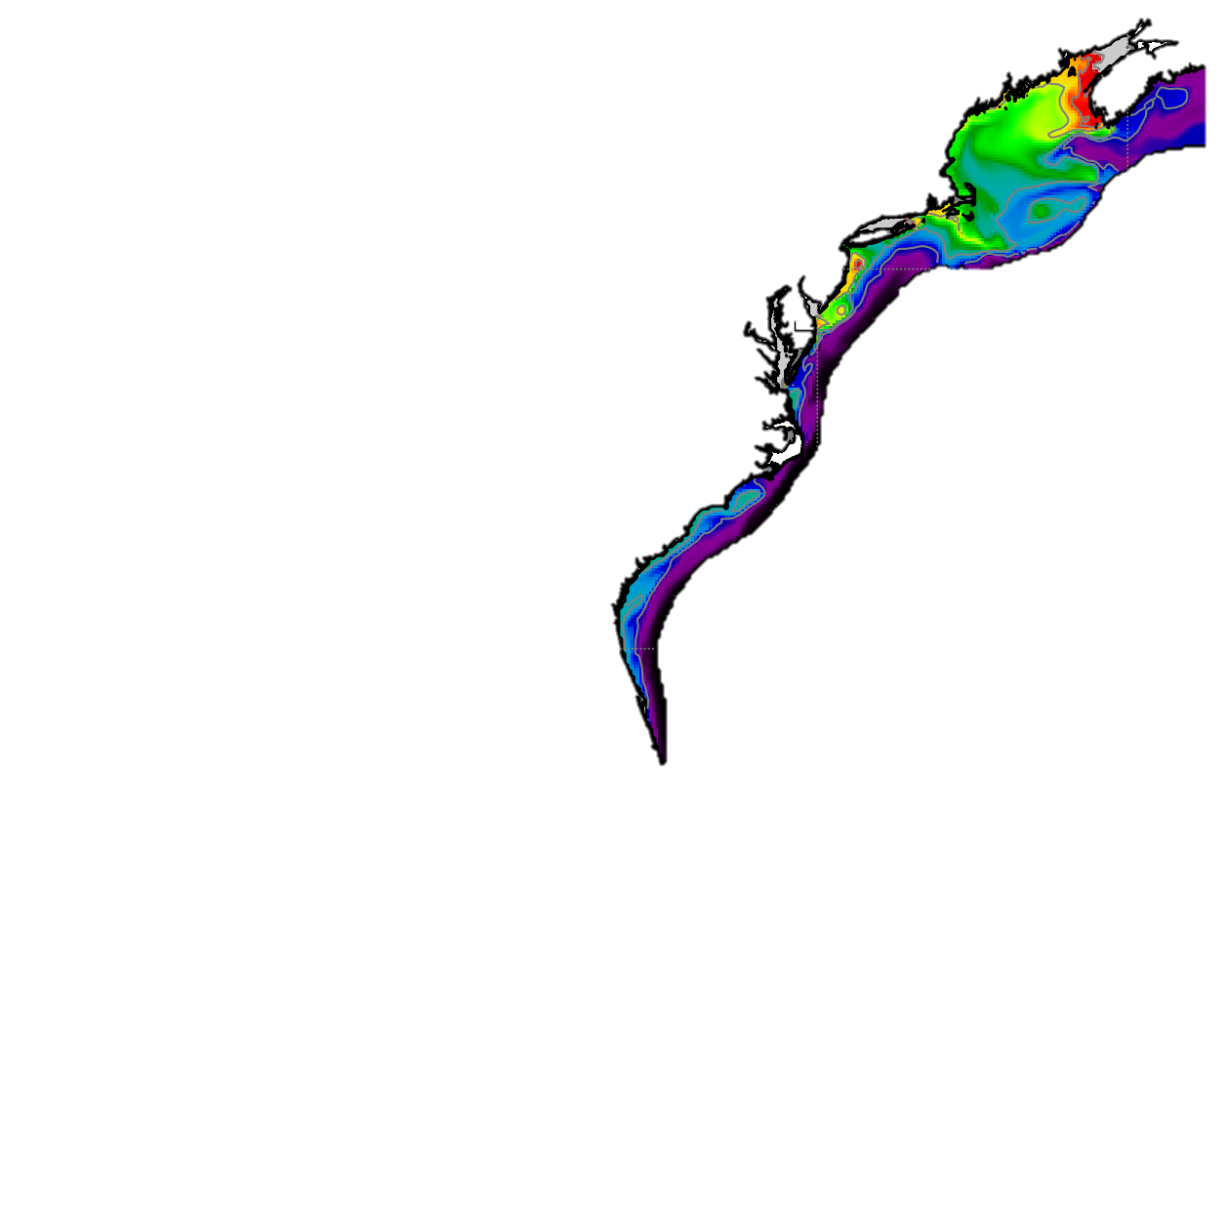
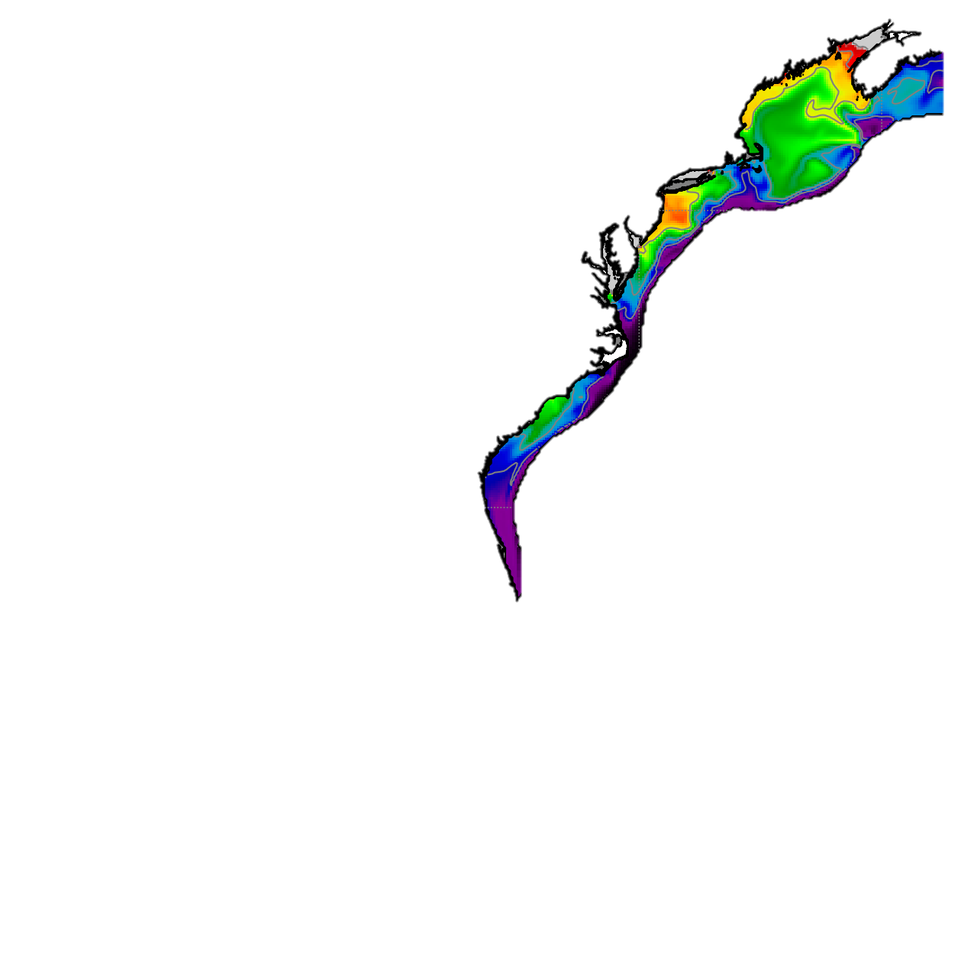

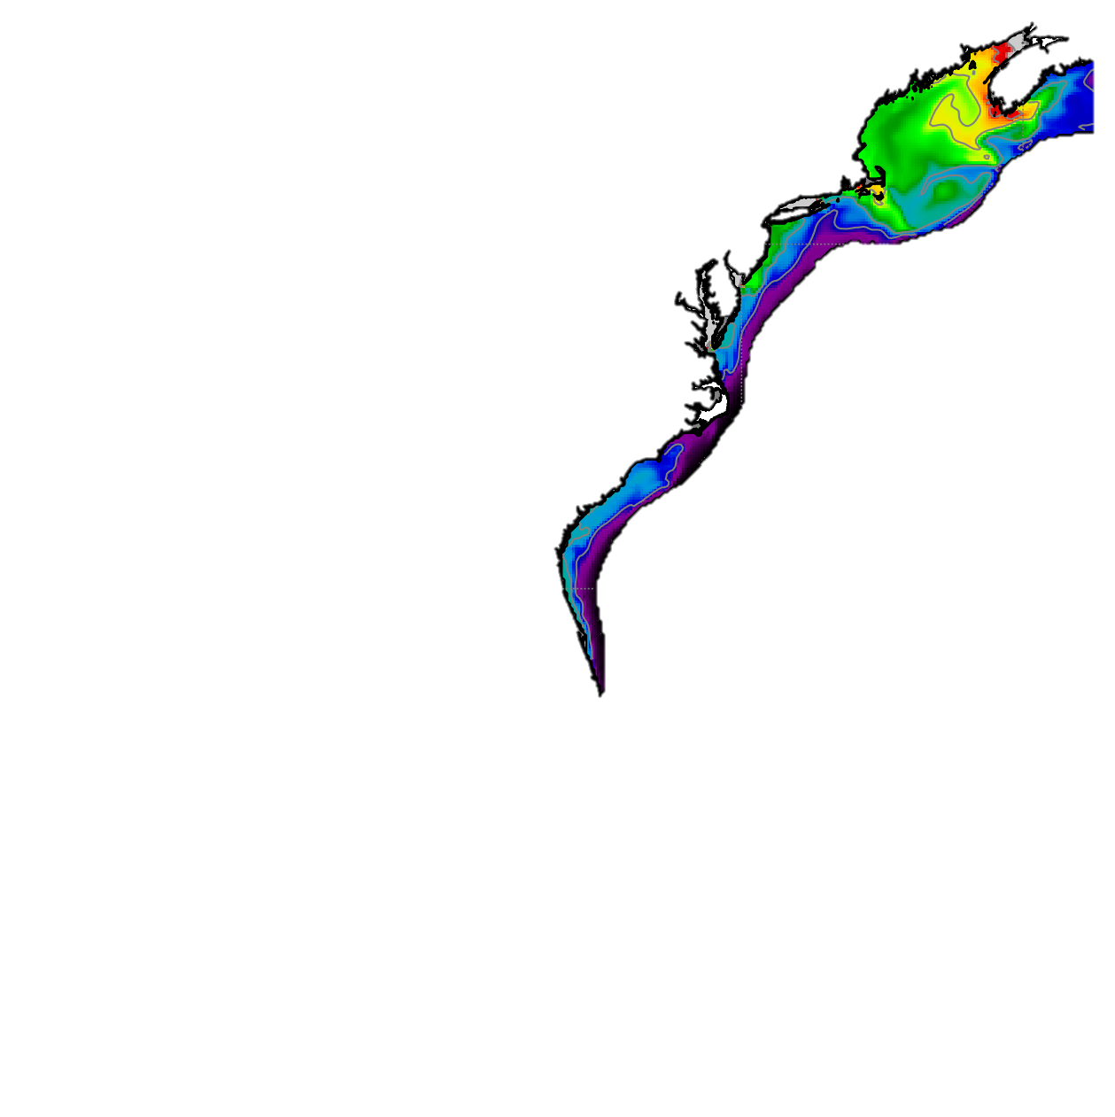
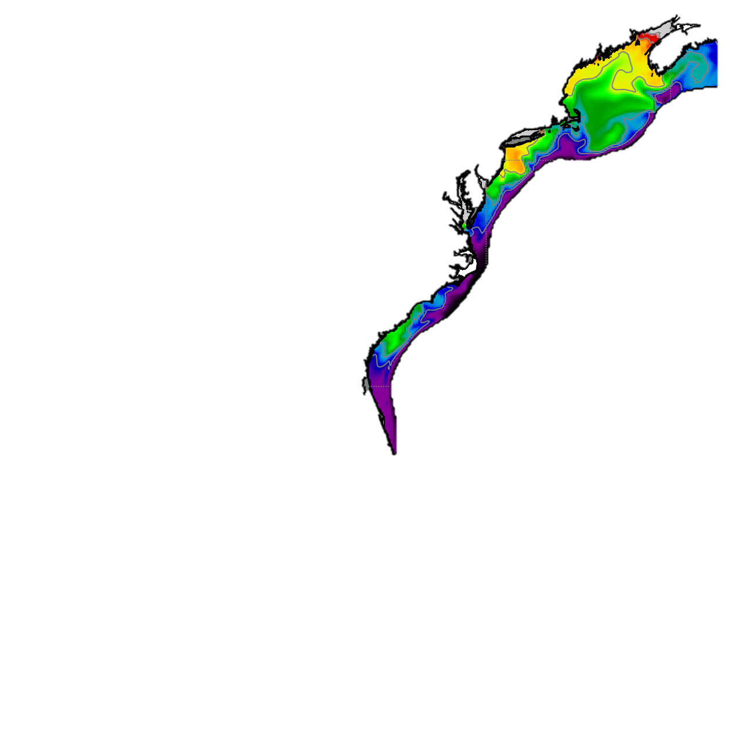
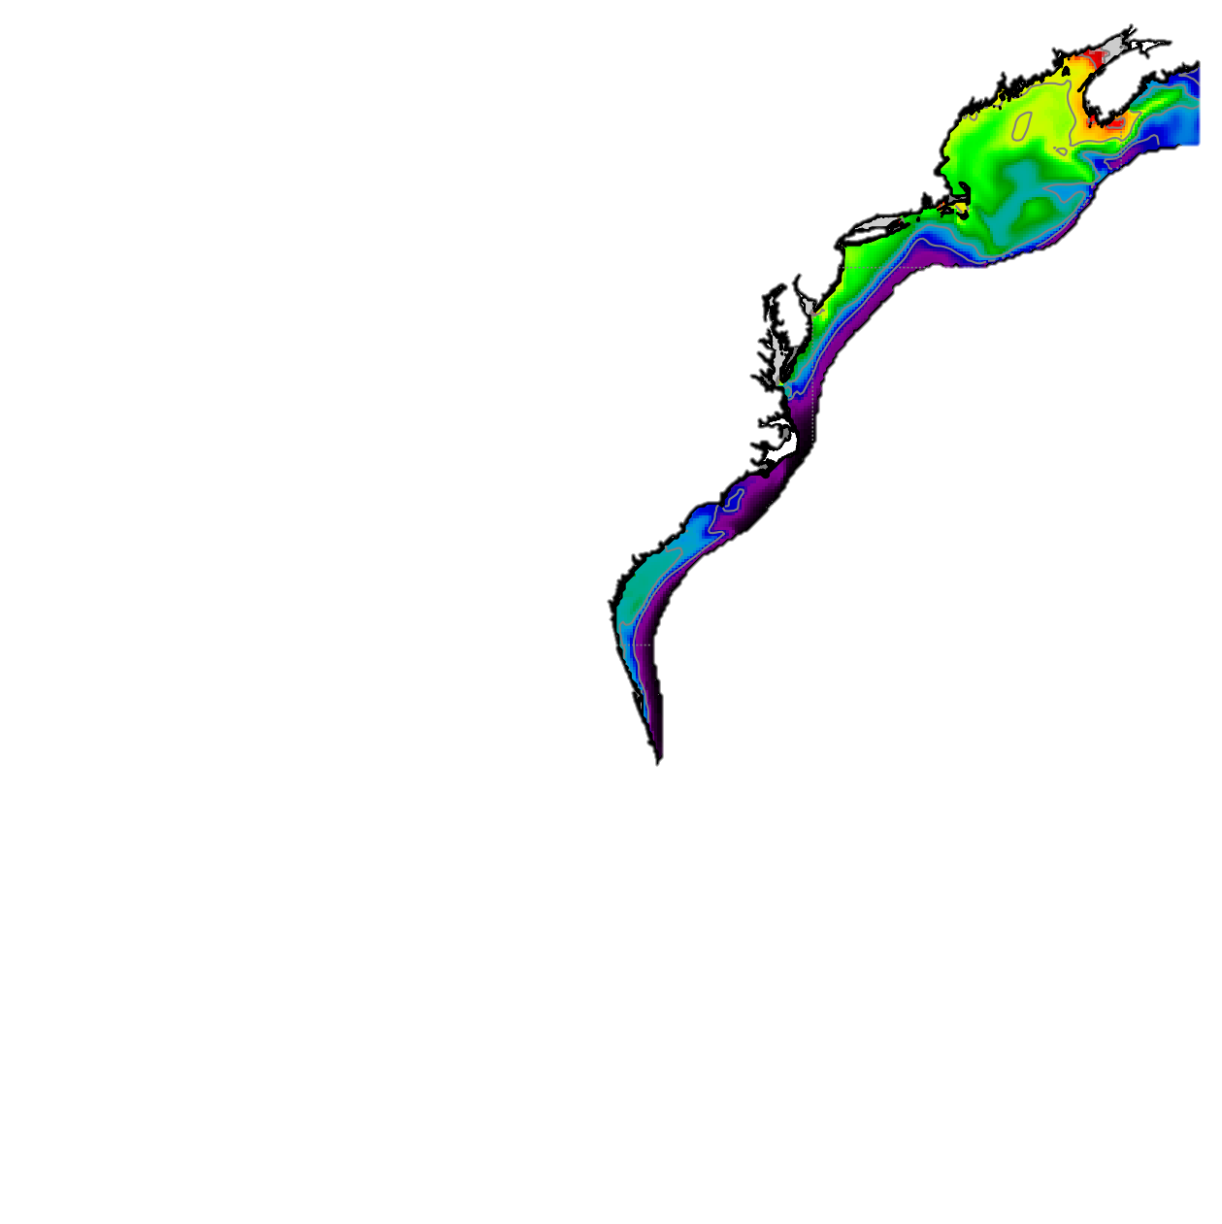

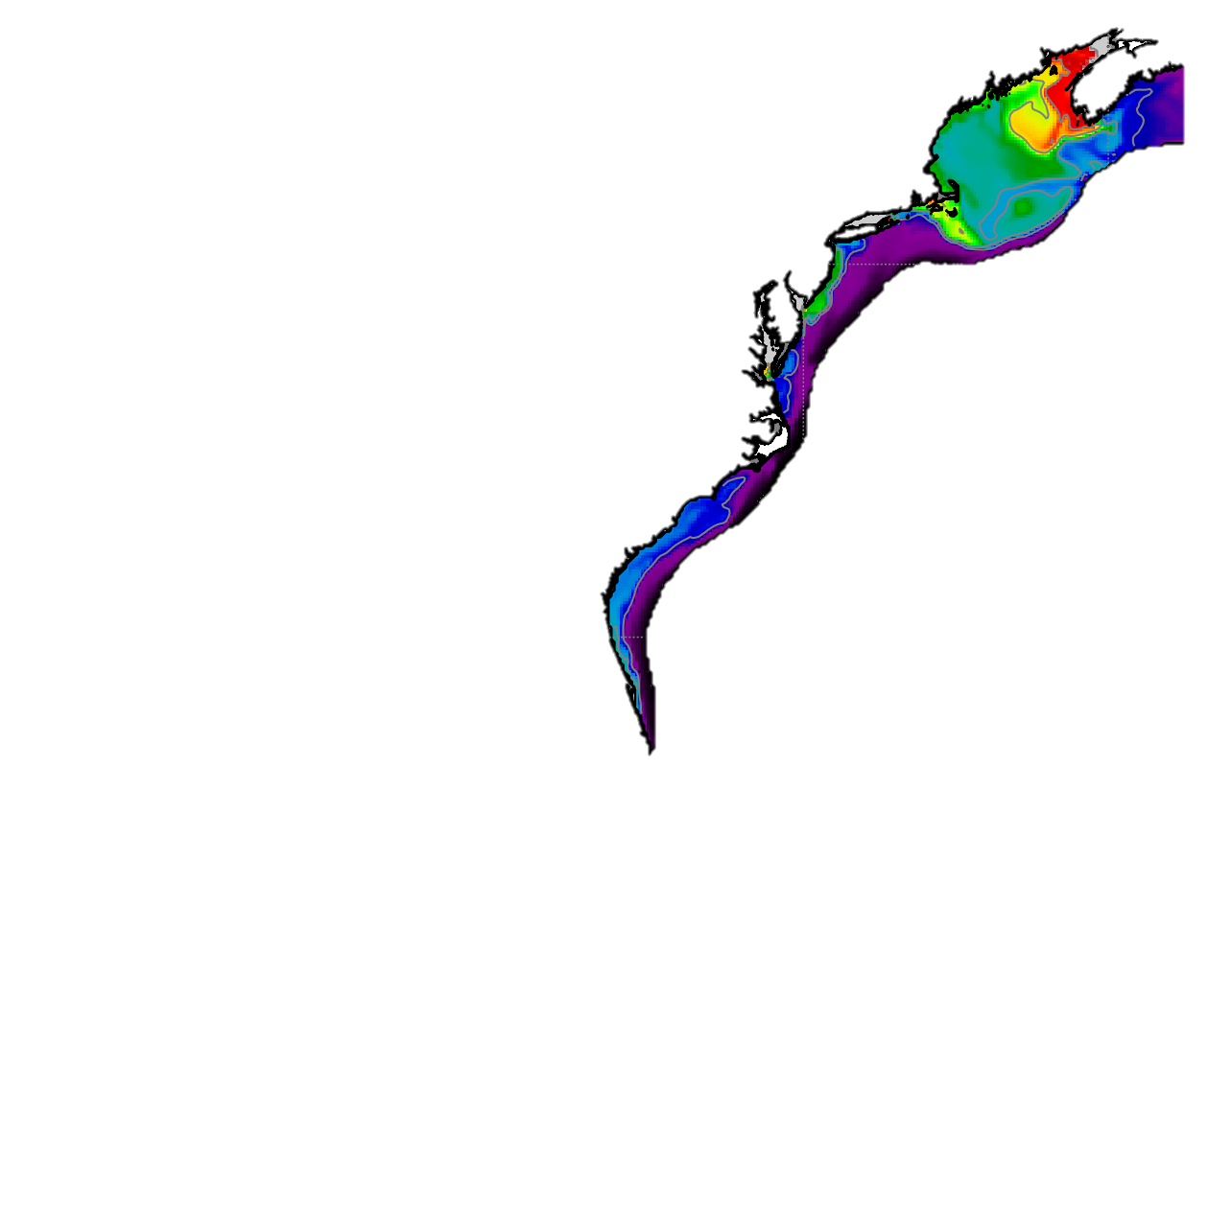

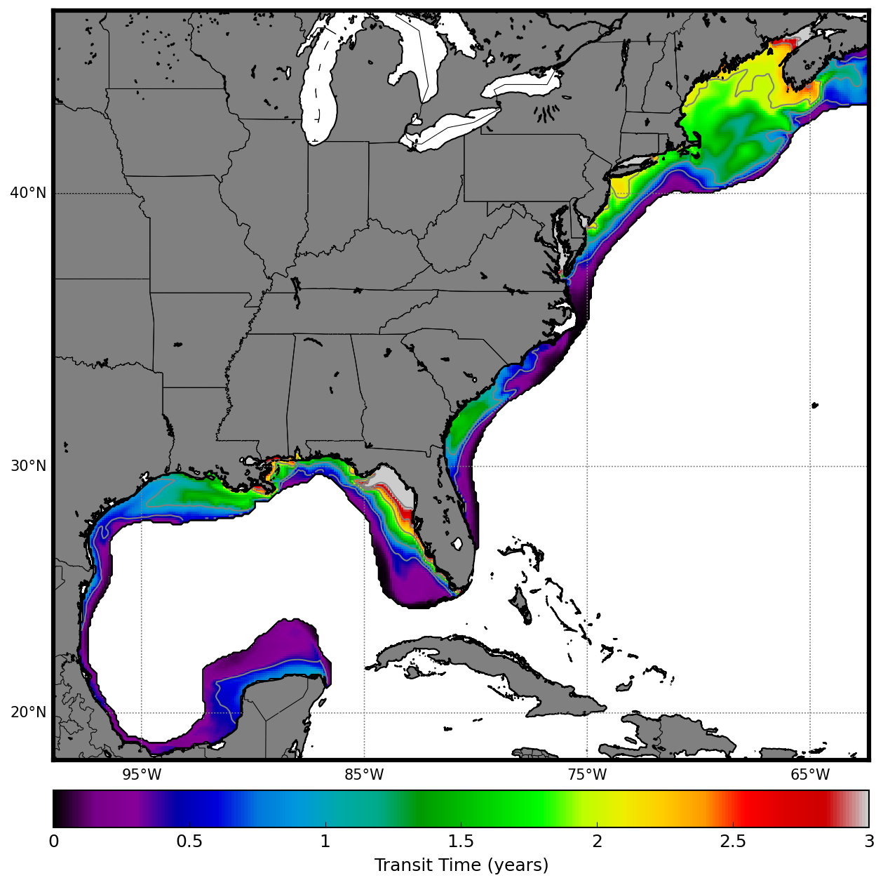
Jan
Feb
Mar
Apr
May
Jun
Jul
Aug
Sep
Oct
Nov
Dec
N
0
0.5
1
1.5
2
2.5
3
Surface Residence Time (years)
Rotation: 41
Size: 60%

Slide 5


